Slide 1
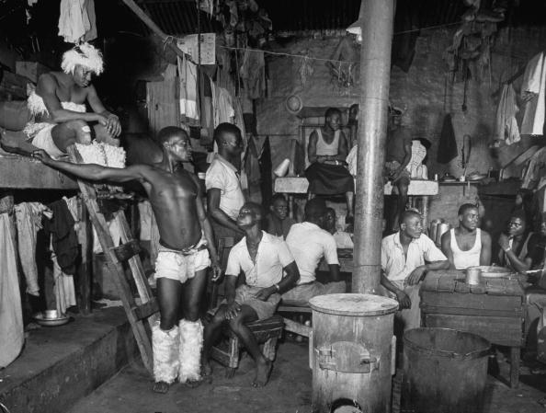
Migrant Workers
Mineral Revolution

Slide 2
Migrant Workers
African kingdoms lost its independence
New taxes imposed: hut tax; poll tax
Africans should be turned into mineworkers
At first chiefs sent unmarried men in age cohorts to pay the taxes
Became a rite of passage to test their manhood
When taxes increased - married men became migrant workers too

Slide 3
Migrant Workers
Contracts were about 2 months but increased to 12 months later
White supervisors could decide if they thought mine workers did a satisfactory job
It would only count as a day after an approval!
Could thus be longer than 12 months
Breach of contract = arrest

Slide 4
Could not bring their families:
They were only paid as single men
Mineworkers had to live in same-sex dorms
No family housing
Pass Laws: black men had to carry documents that identified where they could live and work

Slide 5
When they came home
There was great excitement
They often brought gifts and other items
A lot of them also lost their lives in the mines
Others found life in the city too exciting to return home
It also caused a gap between experience of old and young

